Slide 1
Flask
Lecturer: Ngo Huy Bien
Software Engineering Department
Faculty of Information Technology
VNUHCM - University of Science
Ho Chi Minh City, Vietnam
nhbien@fit.hcmus.edu.vn

Slide 2

Objectives

Slide 3

Contents

Slide 4

References

Slide 5
1. Create Virtual Environment
mkdir flasky
cd flasky
python -m venv myenv
# On macOS:
source ./myenv/bin/activate
# On Windows:
"./myenv/Scripts/activate"

Slide 6
2. Install flask
pip install flask

Slide 7
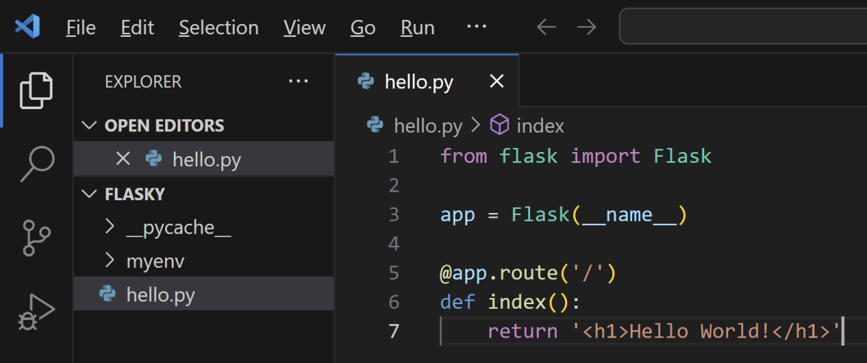
3. Create Hello World

Slide 8
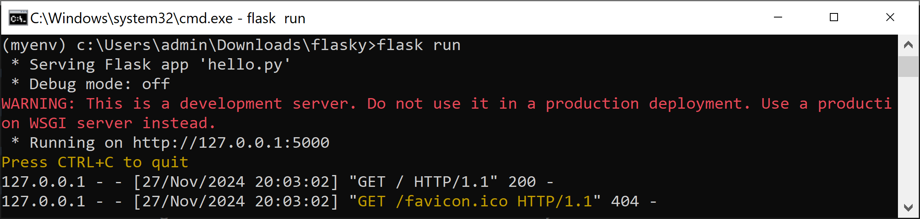
4. Run the Hello World
# On Windows:
set FLASK_APP=hello.py
set FLASK_DEBUG=1
# On macOS:
export FLASK_APP=hello.py
flask run
flask run --host=0.0.0.0 --port=5000

Slide 9
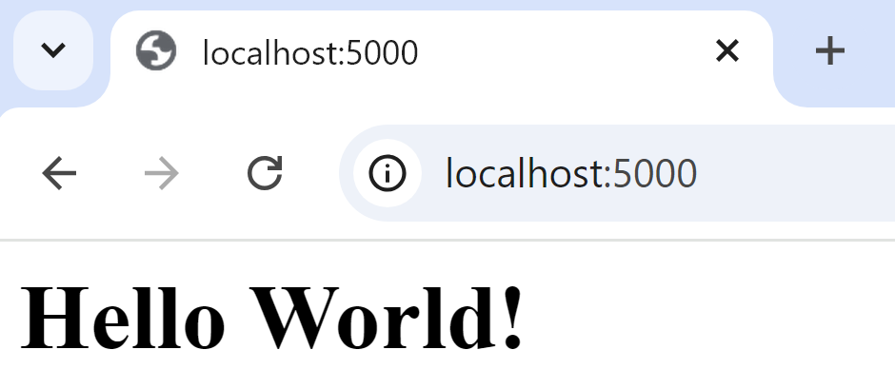
5. Test the Hello World
http://localhost:5000

Slide 10


Slide 11
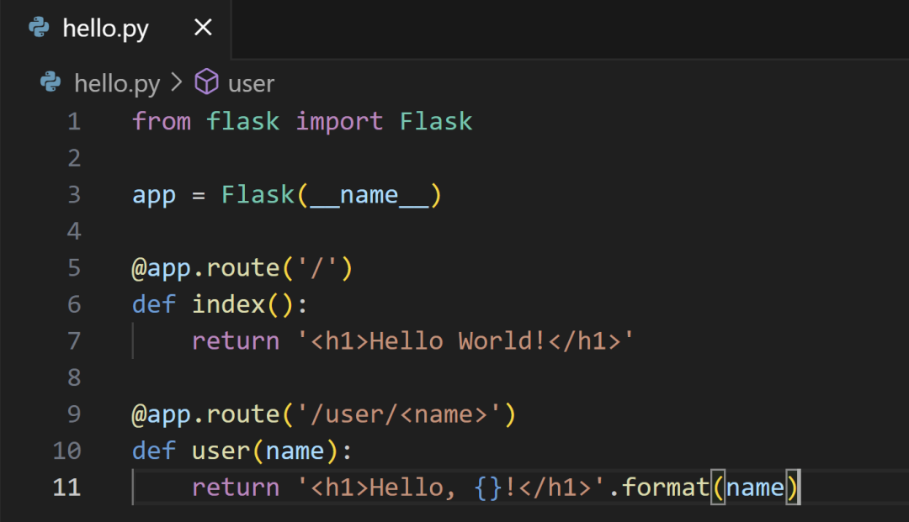
1. Create a Route
http://localhost:5000/user/Bien

Slide 12
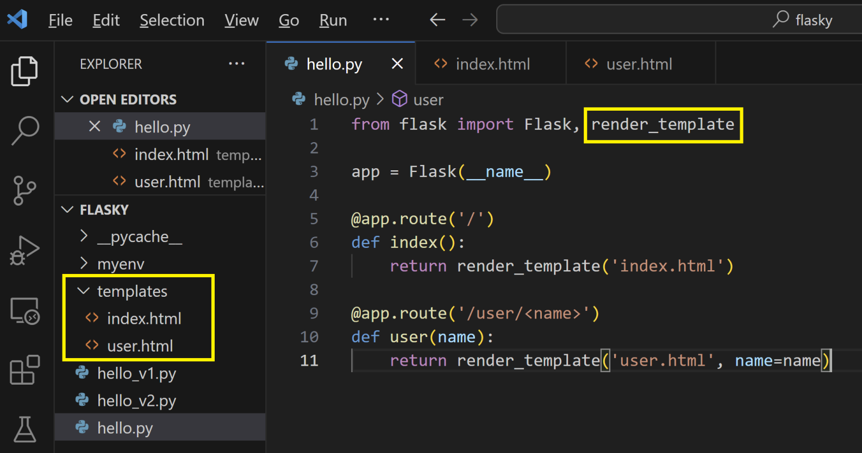
2. Use Templates
http://localhost:5000/user/Bien

Slide 13
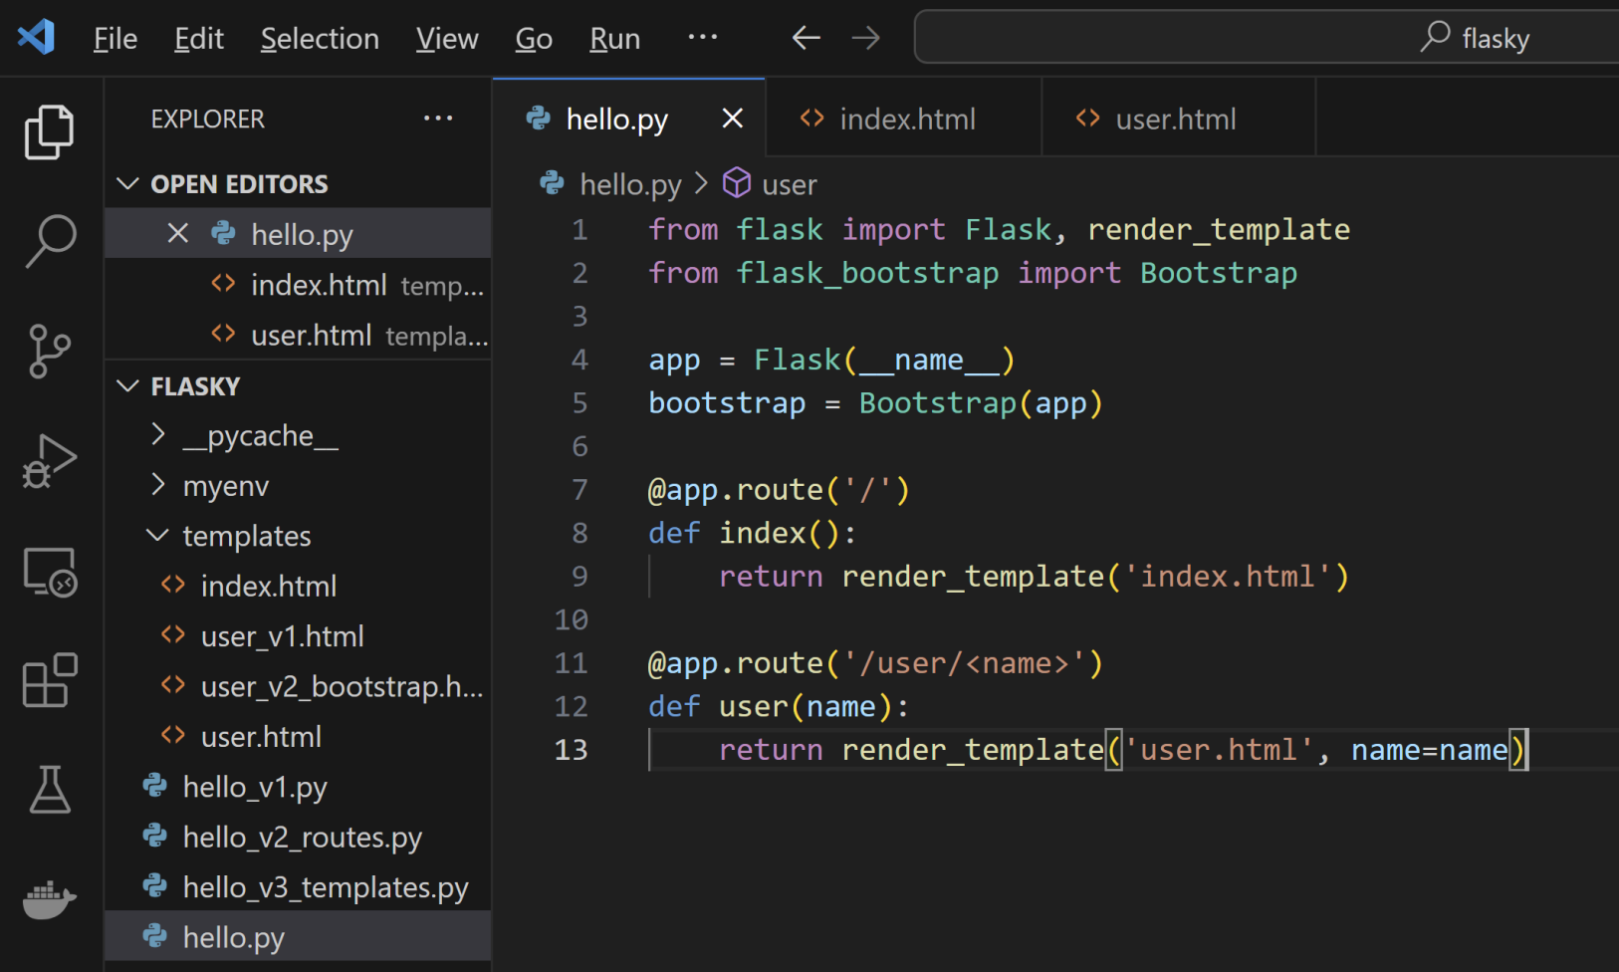
3. Use Bootstrap
pip install flask-bootstrap

Slide 14
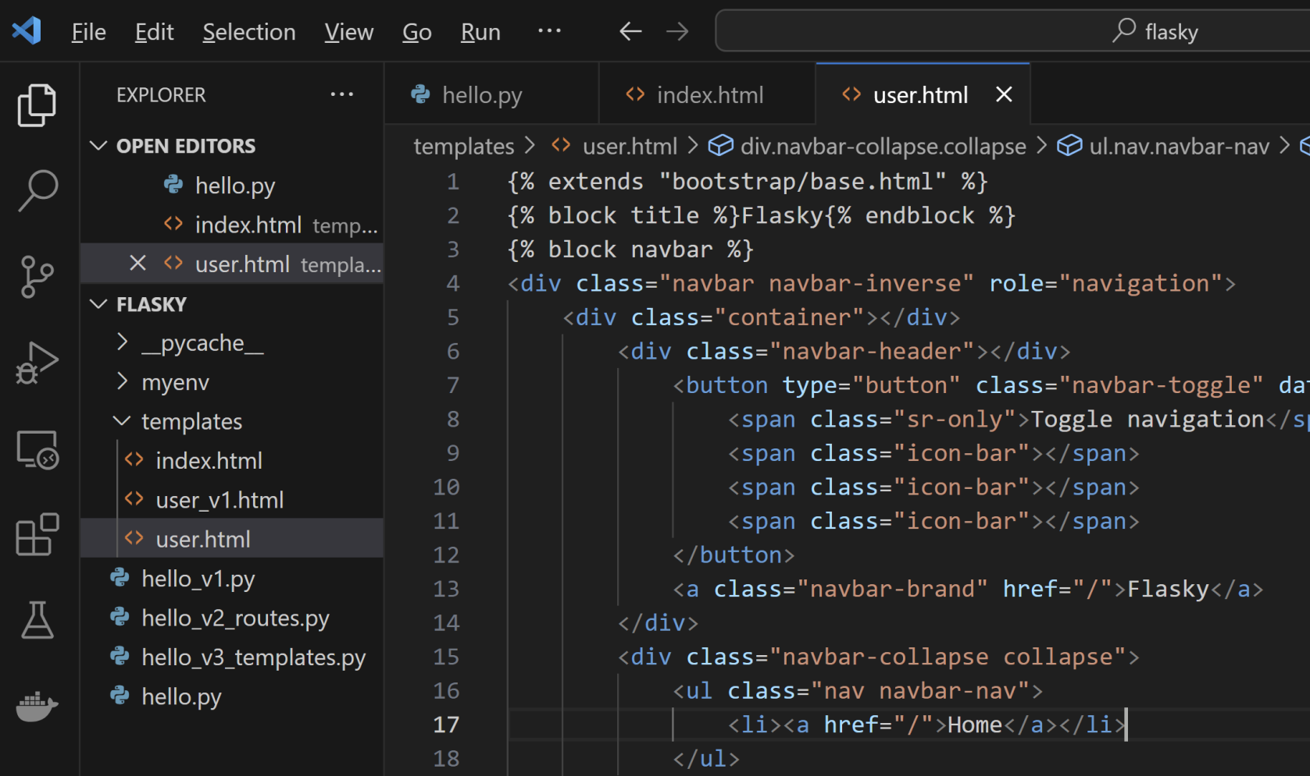
4. Modify Template to use Bootstrap

Slide 16
1. Install Web Forms Extension
pip install flask-wtf

Slide 17
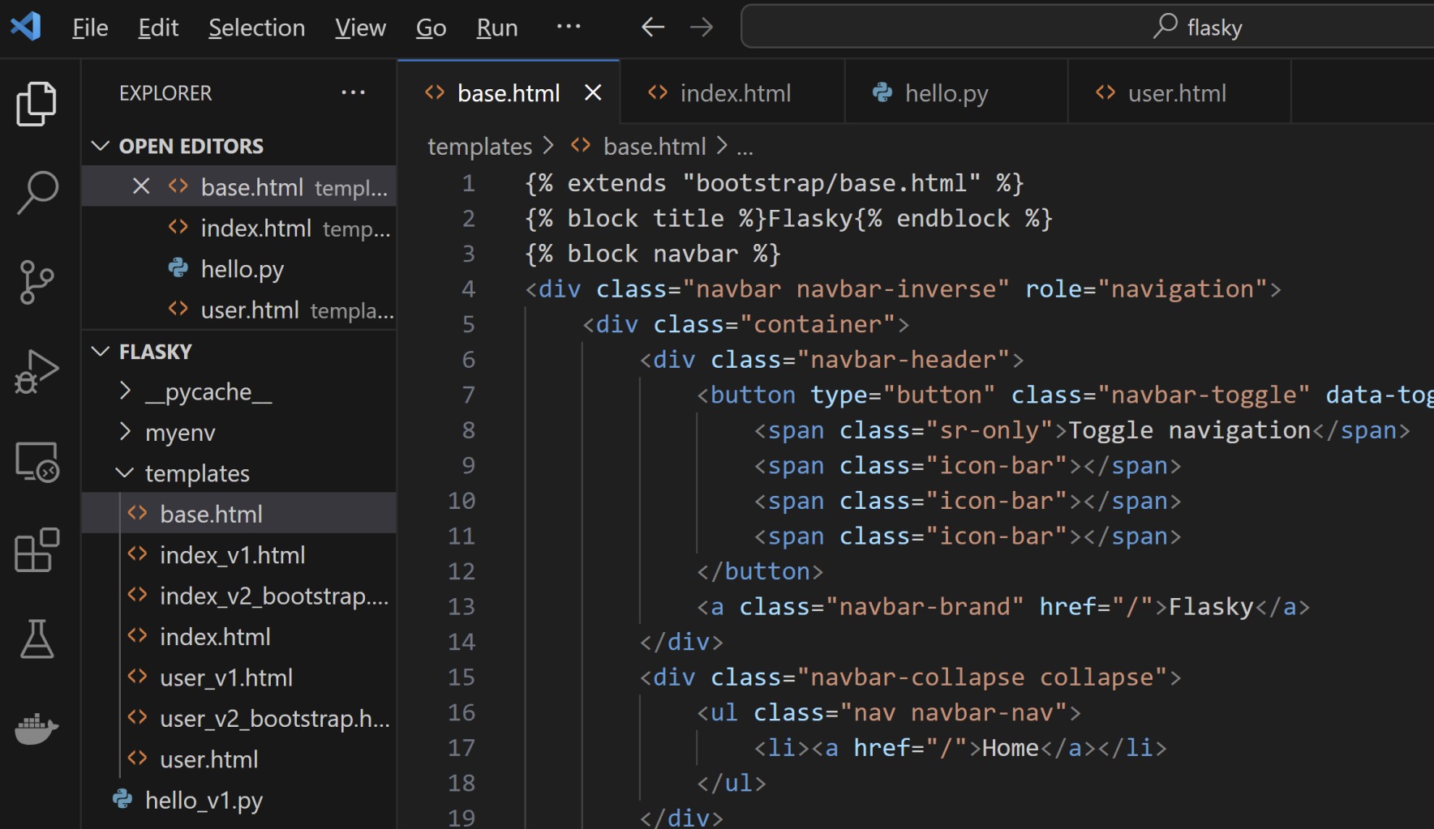
2. Create Base Template

Slide 18
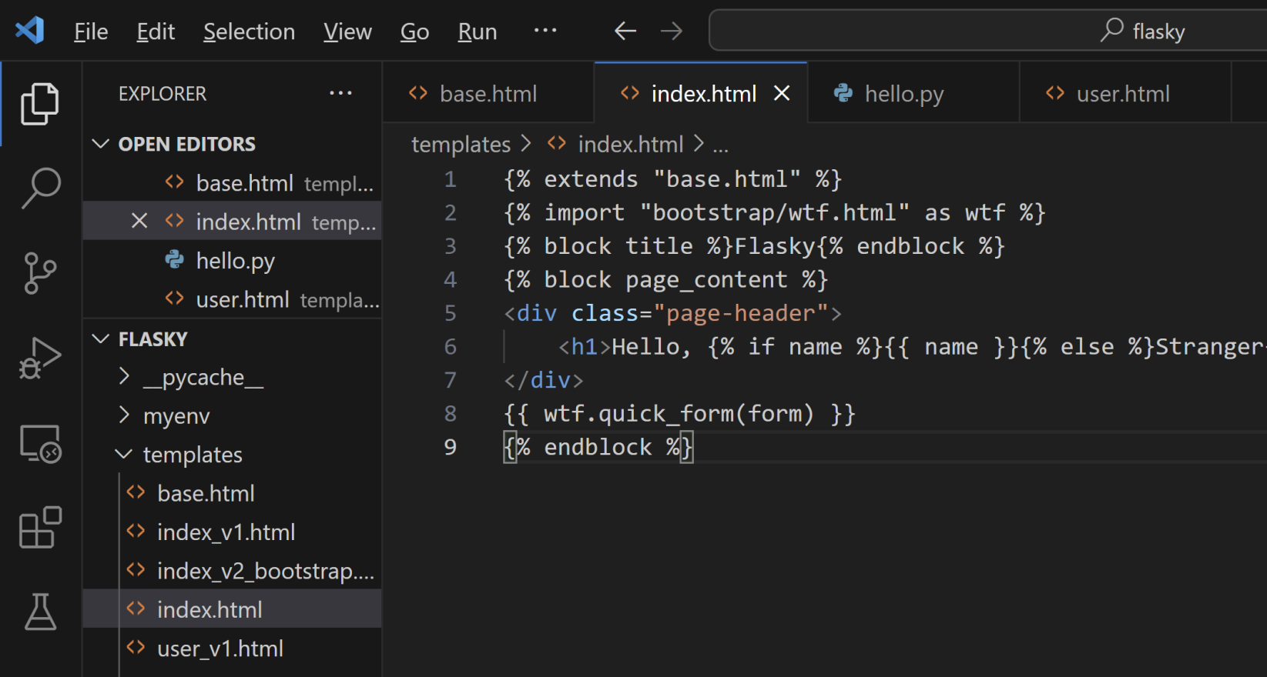
3. Create View

Slide 19
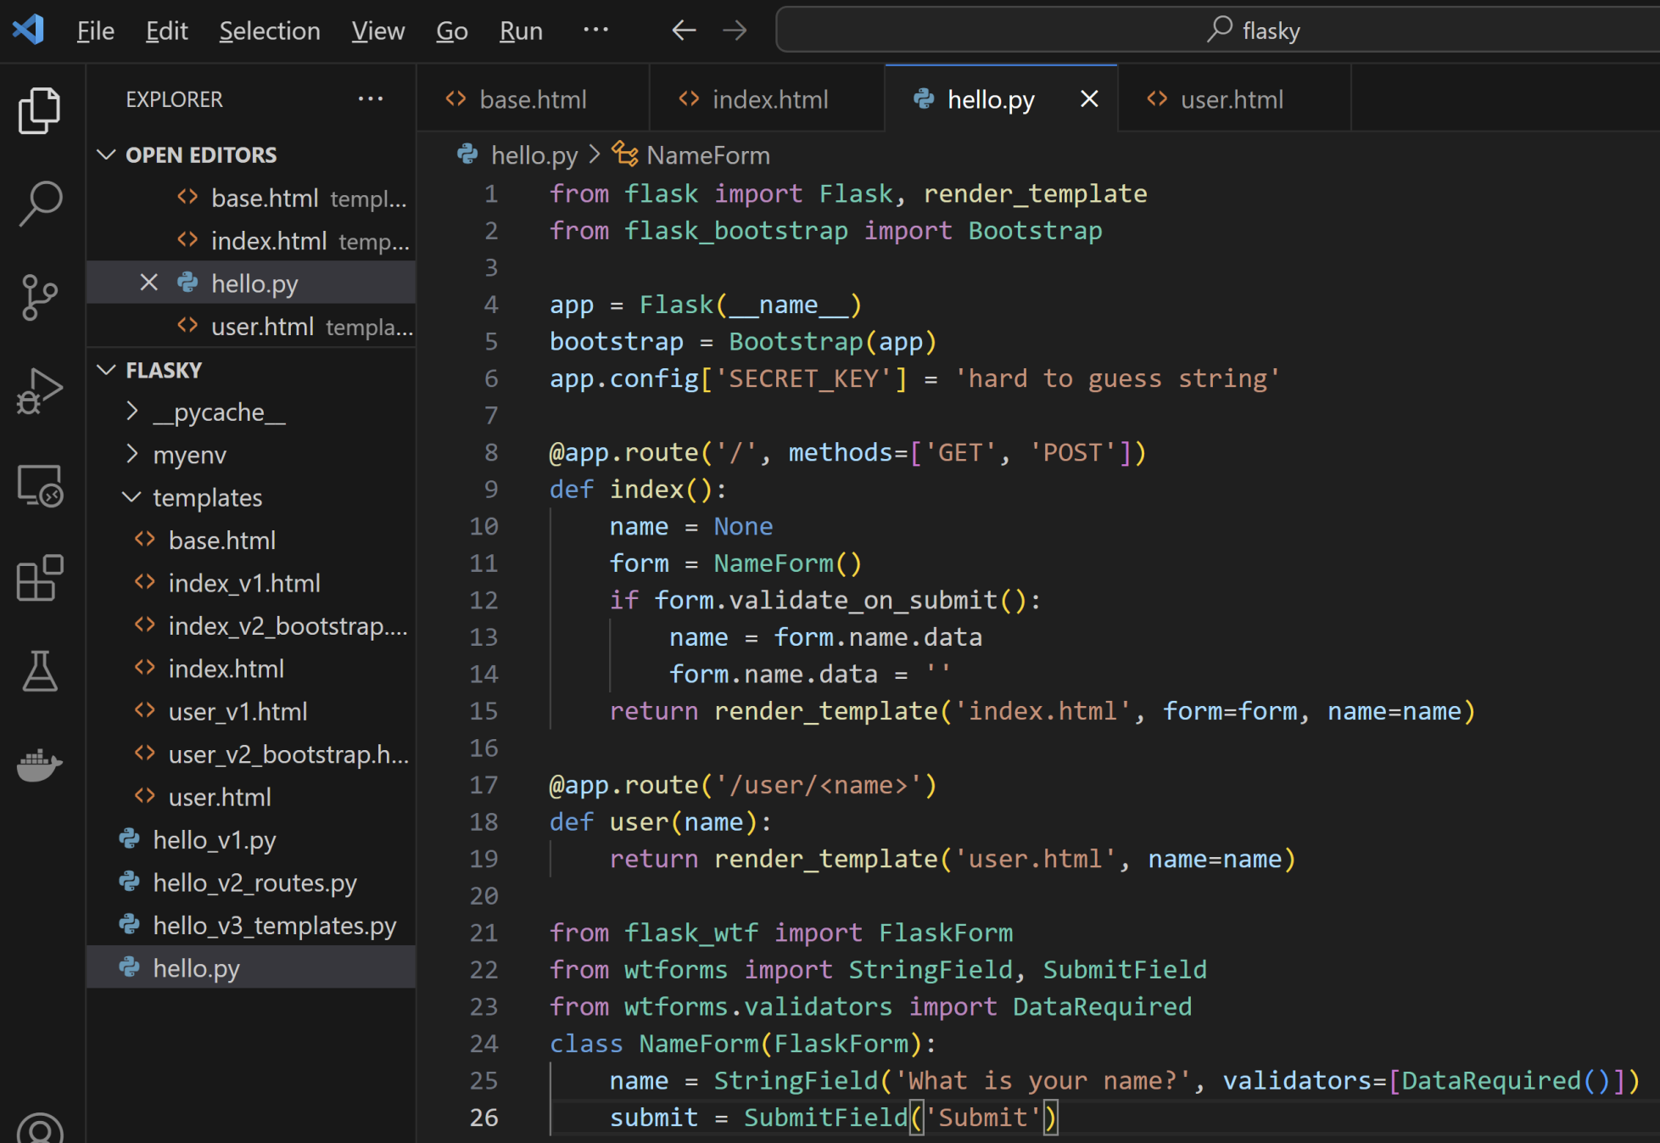
4. Configure and Handle Form

Slide 21
1. Install ML Packages
# GPU on macOS:
pip install torch torchvision torchaudio
# GPU on Windows:
pip install torch torchvision torchaudio --index-url https://download.pytorch.org/whl/cu118
pip install diffusers transformers huggingface_hub accelerate sentencepiece ftfy beautifulsoup4

Slide 22
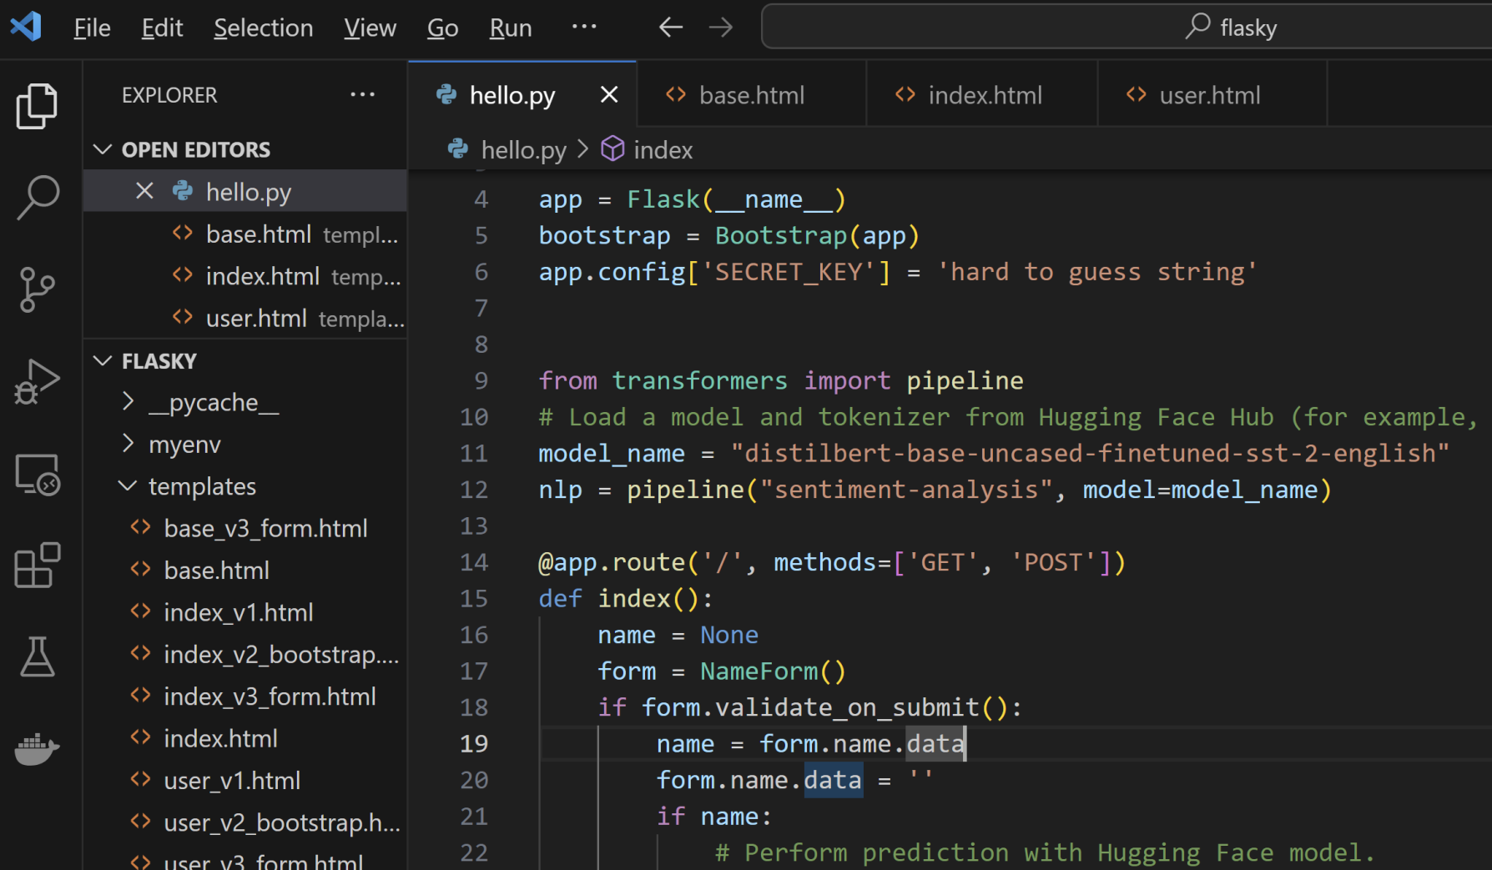
2. Call Model API

Slide 23
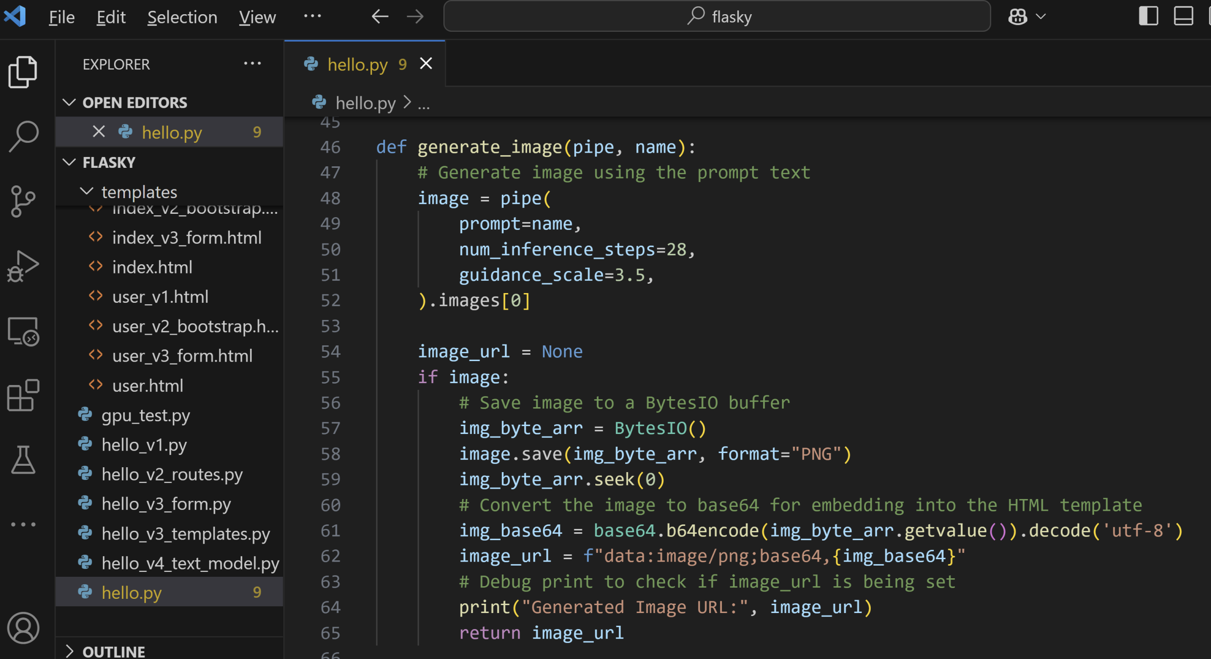
3. Generate Image from Text

Slide 24
4. Add Progress Bar

Slide 25

Thank You & See You Again

